Slide 1
SAFETY REQUIREMENTS UCLA DEPARTMENT OF CHEMISTRY AND BIOCHEMISTRY
Faculty Meeting August 28, 2012
Lab Safety Officers Meeting August 30, 2012

Slide 2
What the Agreement (Appendix A) Covers
GENERAL
Lab Safety Manual and Chemical Hygiene Plan
New/Visiting Principal Investigator Training
Existing Principal Investigator Training
New Laboratory Personnel Training
Existing Laboratory Personnel Training
Standard Operating Procedures (Chemical Classification List )
Procedures for Use of Pyrophoric Reagents
PPE (Personal Protective Equipment) Assessment
Minimum PPE Requirements
PPE Requirements - Lab Coats
PPE Requirements - Flame Resistant Lab Coats
PPE Requirements - Lab Coats Outside of Lab Areas
PPE Requirements - PPE Cleaning
PPE Requirements - Eye Protection
PPE Requirements - Additional PPE
PPE Requirements - Costs and Documentation
PPE Requirements - Deficiencies
EH&S Inspections
Enhanced Cal/OSHA Reporting and Investigation
Enhanced Cal/OSHA Inspections
TRAINING
PROCEDURES
PPE
COMPLIANCE

Slide 3
I. Lab Safety Manual and Chemical Hygiene Plan
All laboratories must maintain a formal written Laboratory Safety Manual and Chemical Hygiene Plan in full compliance with all applicable California Code of Regulations, Title 8 Sections
Copies of the Laboratory Safety Manual must be provided to all lab personnel. Electronic copies are acceptable, provided such manuals are readily accessible to all lab personnel
Researchers must know the contents and sign an acknowledgement in the manual
The manual must be reviewed and updated annually
http://www.ehs.ucla.edu/LabSafetyManual.pdf

Slide 4
II. New/Visiting Principal Investigator Training
All new or visiting Principal Investigators are prohibited from operating any laboratory facility, or directing or supervising any employees within any laboratory facility without first completing
Laboratory Safety Training program for Principal Investigators
Formal training covering University policy concerning the Principal Investigators responsibilities for Laboratory Safety.
Laboratory Safety Training for PI's and Lab Supervisors:
http://map.ais.ucla.edu/go/1003938
Lab Safety Orientation Fact Sheet:
http://ehs.ucla.edu/LabSafetyOrientation.pdf

Slide 5
III. Existing Principal Investigator Training
All existing Principal Investigators are required to complete
a Laboratory Safety Training program for Principal Investigators
Formal training covering University policy concerning the Principal Investigators responsibilities for Laboratory Safety
Annual retraining in Laboratory Safety.

Slide 6
IV. New Laboratory Personnel Training
Before beginning ANY laboratory work, all new laboratory personnel must complete
1) a Laboratory Safety Training Program
2) Formal training covering University policy concerning an individual's right and responsibilities relative to lab safety
Laboratory Safety Fundamental Concepts and Laboratory Safety Course:
http://map.ais.ucla.edu/go/1003938
Lab Safety Training Matrix:
http://ehs.ucla.edu/Pub/Lab%20Training%20Matrix.pdf

Slide 7
V. Existing Laboratory Personnel Training
All existing laboratory personnel must complete
a Laboratory Safety Training Program,
Formal training covering University policy concerning an individual's right and responsibilities relative to lab safety
Annual retraining in Laboratory Safety
Laboratory Safety Fundamental Concepts and Laboratory Safety Online Refresher courses: http://map.ais.ucla.edu/go/1003938
Lab Safety Training Matrix:
http://ehs.ucla.edu/Pub/Lab%20Training%20Matrix.pdf

Slide 8
VI. Standard Operating Procedures
All laboratories must ensure compliance with Title 8 requirements for Standard Operating Procedures (SOPs)
SOPs shall be written for all chemicals used in the laboratory listed in the Chemical Classification List (next slide)
All laboratories must modify each SOP template for use in the specific laboratory
The PI and all personnel responsible for performing the procedures detailed by the SOP shall sign each SOP, acknowledge the contents, requirements and responsibilities outlined
Copies of all SOPs relevant to that particular laboratory's operations must be maintained in each Laboratory Safety Manual or a separately designated manual

Slide 9
Chemical Classification List
Acutely Toxic Chemicals
Regulated Carcinogens
Select Carcinogens
Reproductive Toxins
Explosives
Peroxide Forming Chemicals
Strong Corrosives
Strong Oxidizing Agents
Strong Reducing Agents
Pyrophoric Reagents
Water Reactive Chemicals
About 500 individual chemicals or chemical classes

Slide 10
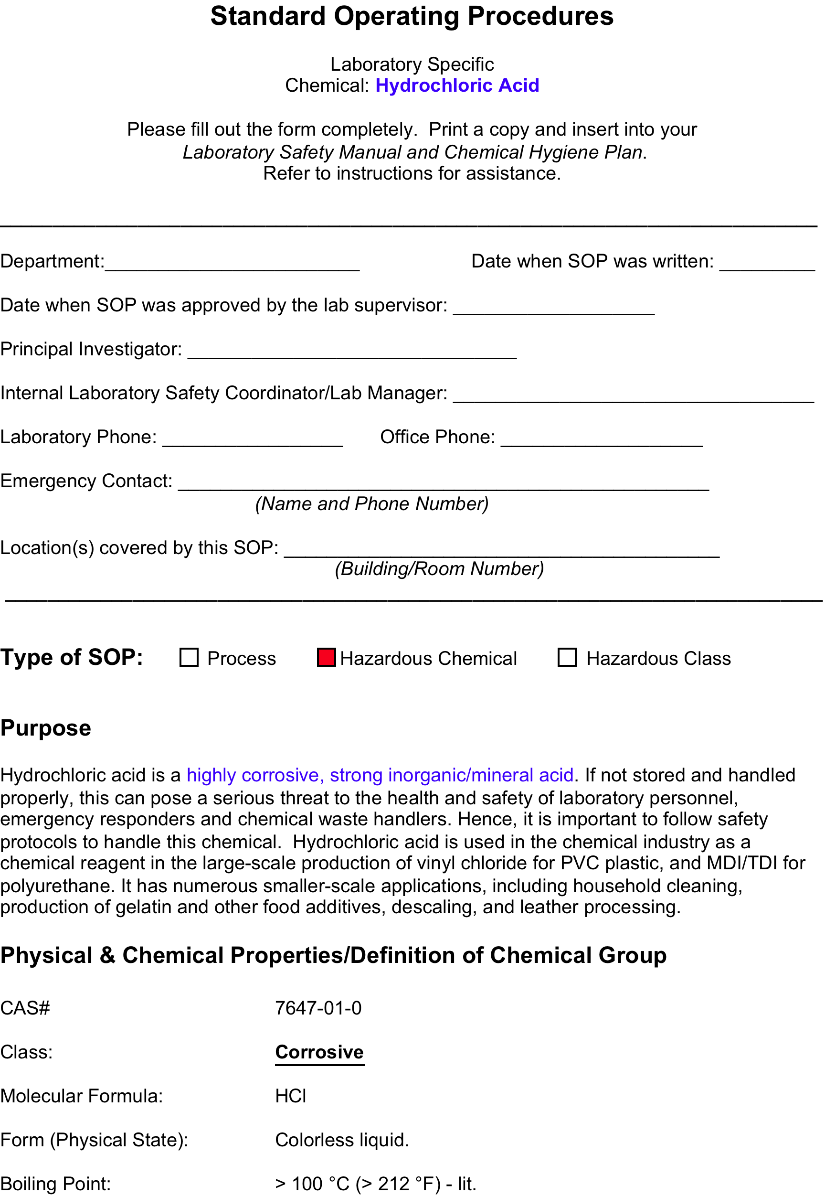
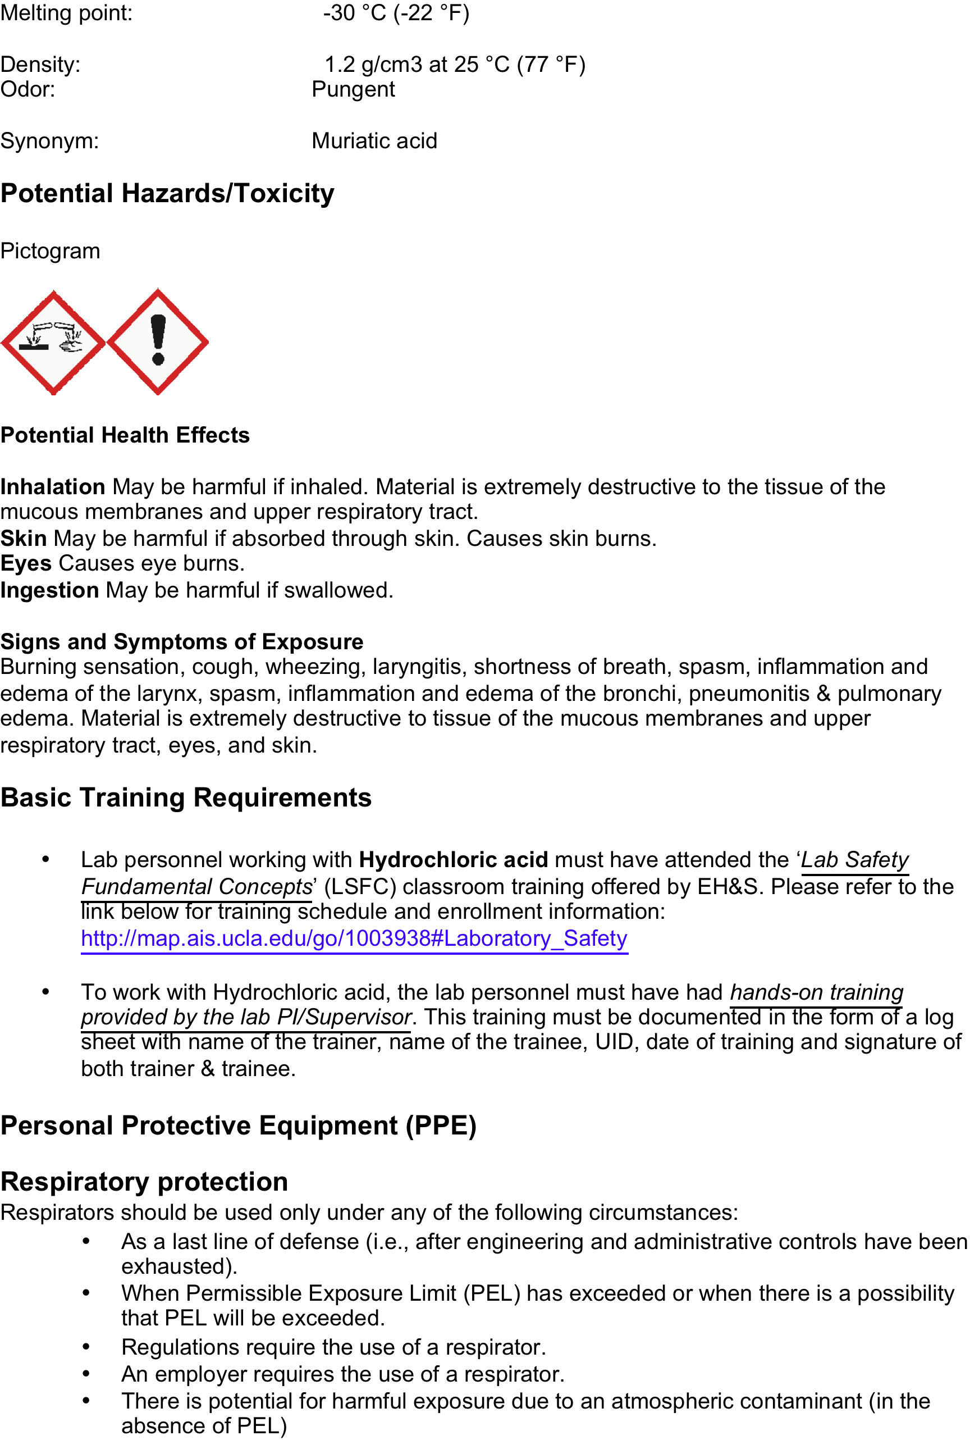

Slide 11
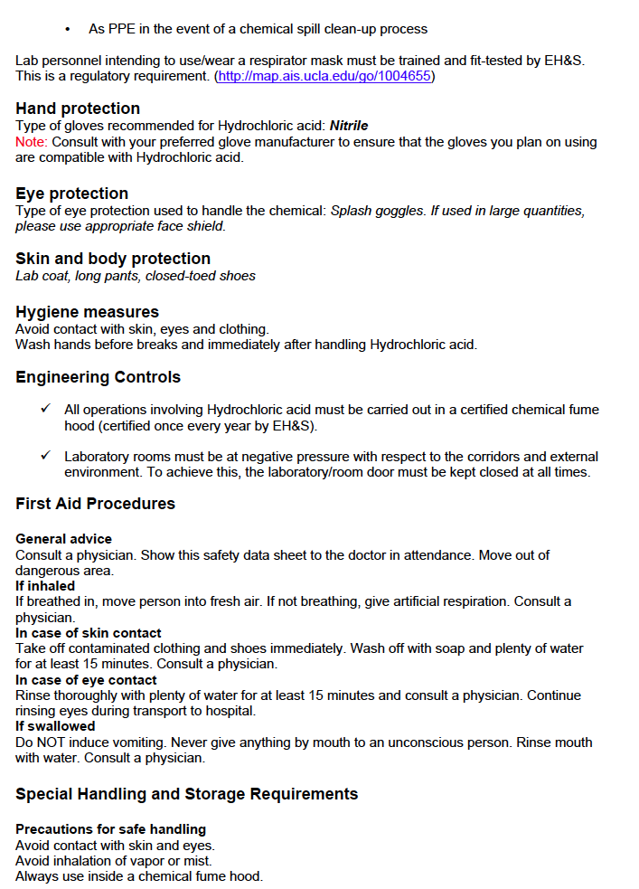
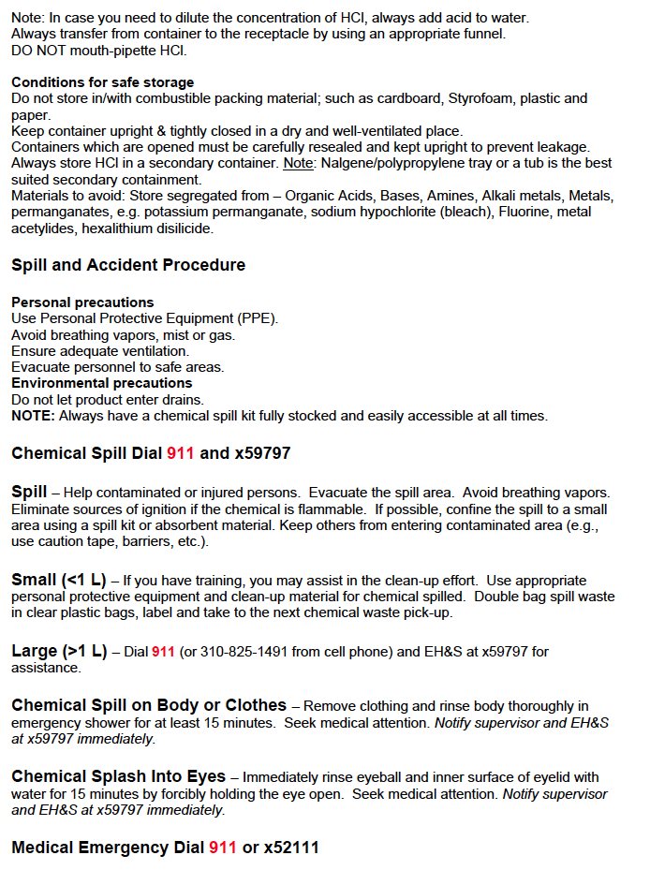

Slide 12
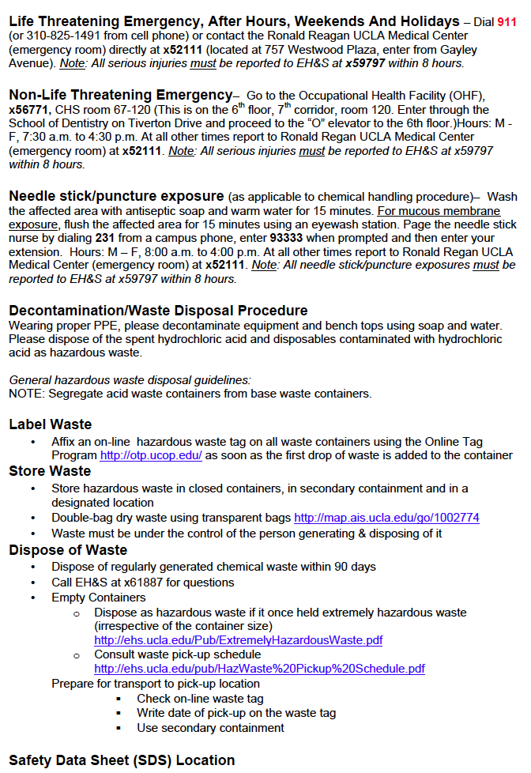
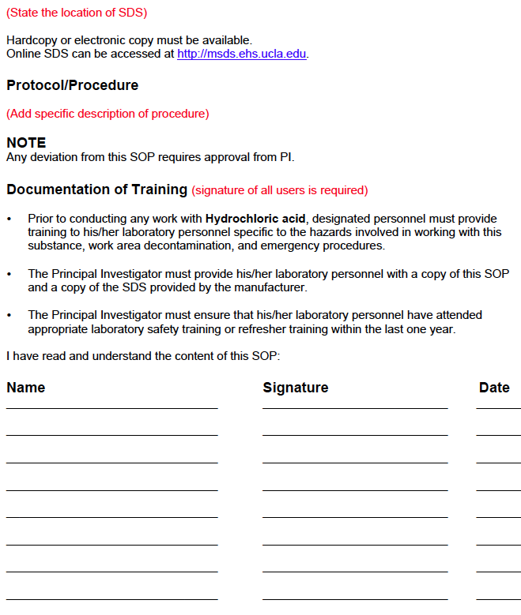

Slide 13
Standard Operating Procedures
In addition to SOP write-ups on individual chemicals and chemical classes, research groups should have write-ups on labware, techniques, physical hazards, etc.
Distillations
Electrical Connections
Gas Cylinders
Glass Blowing
Heating Baths
High Pressure Apparatus
Low Pressure Apparatus
High Temperature Apparatus
Low Temperature Apparatus
Lasers
Ovens
Solvent Stills
Sterilization Methods
Vacuum Pumps

Slide 14
Standard Operating Procedures
UCLA EH&S SOP Template Library:
http://www.sop.ehs.ucla.edu/
UCLA EH&S Job Safety Analysis (JSA) Template Library:
http://jsa.ehs.ucla.edu/
Chemical Classification List (Exhibit 1):
http://ehs.ucla.edu/ExhibitAChemList.pdf
Lists of Hazardous Compounds
http://www.chemistry.ucla.edu/pages/safety
UCLA EH&S Fact Sheet, Chemical Storage and Segregation:
http://ehs.ucla.edu/ChemStorage.pdf

Slide 15
VII. Procedures for Use of Pyrophoric Reagents
UCLA researchers must maintain and follow written procedures for the safe use of pyrophoric reagents
The written procedures shall be made readily available to lab personnel
Lab Personnel should read and sign pyrophoric reagents SOP
SOP - Procedures for Safe Use of Pyrophoric Liquid Reagents http://www.chemistry.ucla.edu/file-storage/publicview/pdfs/SOPLiquidReagents.pdf
Pyrophoric Liquids Safety Video:
http://www.youtube.com/watch?v=RaMXwNBAbxc
SOP - Procedures for Safe Use of Pyrophoric Solids
http://www.chemistry.ucla.edu/file-storage/publicview/pdfs/ProceduresSafeSolids.pdf

Slide 16
VIII. PPE Assessment
Every Principal Investigator must complete an independent assessment on the adequacy of Personal Protective Equipment afforded to laboratory personnel
Lab Hazard Assessment Tool (LHAT) allows for PI's to determine required PPE for their lab. https://lsm.ehs.ucla.edu
PPE Selection Guide:
http://ehs.ucla.edu/Pub/PPE_Guidance.pdf
UCLA Policy 905: Research Laboratory Personal Safety and Protective Equipment:
http://www.adminpolicies.ucla.edu/pdf/905.pdf

Slide 17
IX. Minimum PPE Requirements
Full-length pants, or equivalent, and close-toed shoes must be worn at all times by all individuals occupying the laboratory area. The area of skin between the shoe and ankle should not be exposed.
UCLA PPE Policy 905 (Section IV: Safety Requirements, Subsection A): http://www.adminpolicies.ucla.edu/pdf/905.pdf
UCLA Lab Safety Manual and Chemical Hygiene Plan
http://www.ehs.ucla.edu/LabSafetyManual.pdf

Slide 18
X. PPE Requirements - Lab Coats
Laboratory coats, or equivalent, must to be worn while working on, or adjacent to, all bench top procedures utilizing hazardous chemicals, biological or unsealed radiological materials
These laboratory coats must be appropriately sized for the individual and be buttoned to their full length
Laboratory coat sleeves must be of a sufficient length to prevent skin exposure while wearing gloves
UCLA PPE Policy 905 (Section IV: Safety Requirements, Subsection C): http://www.adminpolicies.ucla.edu/pdf/905.pdf
PPE Selection Guide:
http://ehs.ucla.edu/Pub/PPE_Guidance.pdf

Slide 19
XI. PPE Requirements – Flame Resistant Lab Coats
Flame resistant lab coats must be worn when working with pyrophoric materials or flammable liquids
Cotton (or other non-synthetic material) personal clothing must also be worn during these procedures to minimize injury in the case of a fire emergency
UCLA PPE Policy 905 (Section IV: Safety Requirements, Subsection D): http://www.adminpolicies.ucla.edu/pdf/905.pdf
PPE Selection Guide:
http://ehs.ucla.edu/Pub/PPE_Guidance.pdf
Lab coat purchasing guide:
http://www.chemistry.ucla.edu/file-storage/publicview/pdfs/safety-website-files/Flame_Resistant_Laboratory_Coats.pdf

Slide 20
XII. PPE Requirements - Lab Coats Outside of Lab Areas
Laboratory coats may not be worn outside of a laboratory unless the individual is traveling directly to an adjacent laboratory work area
Protective gloves must not be own in any public area outside of the laboratory (i.e. hallways, elevators, offices)
Gloves must be removed prior to handing any equipment that could likely result in cross contamination
UCLA PPE Policy 905 (Section IV: Safety Requirements, Subsection E): http://www.adminpolicies.ucla.edu/pdf/905.pdf

Slide 21
XIII. PPE Requirements - PPE Cleaning
Professional laundry services must be used to maintain the hygiene of laboratory coats
Coats may not be cleaned by researchers at private residences or public laundry facilities
Any clothing that becomes contaminated with hazardous materials must be decontaminated before it leaves the laboratory
UCLA PPE Policy 905 (Section IV: Safety Requirements, Subsection F): http://www.adminpolicies.ucla.edu/pdf/905.pdf

Slide 22
XIV. PPE Requirements – Eye Protection
American National Standards Institute (ANSI) approved eye protection or equivalent engineering controls most be used while handling hazardous chemicals, biological or unsealed radiological materials
UCLA PPE Policy 905 (Section IV: Safety Requirements, Subsection G): http://www.adminpolicies.ucla.edu/pdf/905.pdf
PPE Selection Guide:
http://ehs.ucla.edu/Pub/PPE_Guidance.pdf

Slide 23
XV. PPE Requirements – Additional PPE
Any additional PPE required for safe operations or procedures shall be made available to each exposed or effected employee prior to implementation of any operations or procedures.
Examples: Face Shields, Aprons, Butyl Gloves, Booties
UCLA PPE Policy 905 (Section IV: Safety Requirements, Subsection H): http://www.adminpolicies.ucla.edu/pdf/905.pdf
PPE Selection Guide:
http://ehs.ucla.edu/Pub/PPE_Guidance.pdf
UCLA Lab Safety Manual and Chemical Hygiene Plan
http://www.ehs.ucla.edu/LabSafetyManual.pdf

Slide 24
XVI. PPE Requirements – Costs and Documentation
Employees shall not bear the cost of any required PPE
Written records must be maintained by each laboratory verifying the date of issuance and type of PPE issued, or re-issued, to each laboratory personnel
Chemistry and Biochemistry provides the following form to document PPE issuance: http://www.chemistry.ucla.edu/file-storage/publicview/pdfs/HazardAssessmentPPE.pdf

Slide 25
XVII. PPE Requirements - Deficiencies
No person shall be permitted to work in or occupy any laboratory area without first being provided the required PPE
The Principal investigator or EH&S personnel shall remove any person found by the PI or EH&S personnel working in or occupying any laboratory area without the required PPE until the required PPE is obtained and utilized
Unannounced PPE inspection checklist:
http://ehs.ucla.edu/PPEComplianceInspection.pdf

Slide 26
XVIII. EH&S Inspections
EH&S will conduct comprehensive laboratory safety inspections, in accordance with the UCLA Lab Safety Manual, Chemical Hygiene Plan, and California Code of Regulations Title 8
EH&S shall immediately inform the PI or responsible parties of deficiencies
Critical deficiencies, which are immediately dangerous to life and health, noted during the inspection must be corrected immediately
UCLA Lab Safety Manual and Chemical Hygiene Plan
http://www.ehs.ucla.edu/LabSafetyManual.pdf
Category A inspection checklist:
http://ehs.ucla.edu/CatAChemInspectionChecklist.pdf
Unannounced PPE inspection checklist:
http://ehs.ucla.edu/PPEComplianceInspection.pdf
Laboratory Safety Inspection Checklist:
http://ehs.ucla.edu/LabSafetyInspectionChecklist.pdf

Slide 27
XIX. Enhanced Cal/OSHA Reporting and Investigation
Principal Investigators are required to report within eight hours all reportable occupational injury or illness to UCLA EH&S
EH&S shall immediately inform the Cal/OSHA enforcement unit and the Cal/OSHA Bureau of Investigations
UCLA shall immediately secure the scene and preserve all evidence until the Cal/OSHA enforcement unit and the Cal/OSHA Bureau of Investigations determines that a response is not required
EH&S Hotline: (310) 825-9797
EH&S How to report an injury: http://map.ais.ucla.edu/go/1002890
EH&S Injury Reporting 1,2,3 :
http://ehs.ucla.edu/Pub/IPD_EHS%20123%20Poster.pdf

Slide 28

Reportable
Injuries

Slide 29
XX. Enhanced Cal/OSHA Inspections
The Cal/OSHA enforcement unit or the Cal/OSHA Bureau of Investigations shall have full access to any UCLA facility for the purposes of conducting inspections to determine compliance with its terms
Inspections shall be limited to three annually, during the four-year term of the agreement
Advance notice of inspections shall not be given
Upon arrival Cal/OSHA personnel shall contact a UCLA EH&S representative who will be permitted to be present during the inspection, if that representative is available within 1 hour of initial or attempted contact
Cal/OSHA personnel shall not be precluded from documenting any observable conditions or beginning any inspection where the loss of critical information may, at the determination of Cal/OSHA personnel be likely, while waiting for the arrival of a representative
UCLA EH&S Fact Sheet, Cal/OSHA Inspections:
http://ehs.ucla.edu/OSHA_FS.pdf
Please contact the EH&S Hotline immediately: (310) 825-9797.
UCLA PPE Policy 907:
http://www.adminpolicies.ucla.edu/pdf/907.pdf

Slide 30
OSHA Inspections
Cal/OSHA inspectors make unannounced visits to make sure that the UCLA campus and associated facilities are safe and healthy
The Cal/OSHA visit will start with an opening conference where inspectors will explain the visit
The Cal/OSHA visit will include inspections of work areas
The Cal/OSHA visit can include one-on-one interviews with workers
The Cal/OSHA inspectors can request documents such as the Illness and Injury Prevention Plan, Chemical Hygiene Plan, and SOPs
The Cal/OSHA inspectors will conduct a closing conference to provide inspection results

Slide 31
OSHA Inspection Plan
1) All researchers must be prepared for OSHA inspections
2) All researchers must be prepared for one-on-one OSHA interviews
3) Researchers should tell OSHA inspectors that EH&S must be present for a lab inspection
4) Researchers should locate a conference room for the opening conference, private interviews, and closing conference
5) Researchers should call EH&S Hotline at 825-5689 if EH&S is not already present
6) Researchers should ask for their faculty advisor to be present for the inspection
7) Researchers are welcome to request Craig Merlic to be present (825-5466, 310-922-4792)
8) Researchers should ask for Campus Counsel to be present during any one-on-one interview by OSHA

Slide 32
OSHA Inspection Expectations
1) Researchers must know and follow all safety practices established by EH&S, Department of Chemistry and Biochemistry, and their faculty advisors while working at UCLA
2) Researchers must know the location and contents of the Laboratory Safety Manual
3) Researchers must know the location and contents of the Chemical Hygiene Plan
4) Researchers must know the location and contents of the Illness and Injury Prevention Plan
5) Researchers must know the location and contents of the SOPs established for their research lab

Slide 33
Illness and Injury Prevention Plan
Goals:
Create, maintain and reinforce a safe university environment to protect the health and safety of employees, students and visitors
Demonstrate management commitment and concern for employee safety
Maintain compliance with health and safety codes
Improve efficiency by reducing lost work time due to illness and injuries
Reduce workers' compensation claims and costs
http://map.ais.ucla.edu/go/1002965

Slide 34
Illness and Injury Prevention Plan
Components
Introduction and Scope: Summary of the departmental safety program and objectives
Responsibilities: Roles and accountabilities of supervisors, employees, safety committee members, etc., with regard to the IIPP
Identification and Evaluation of Workplace Hazards: Includes safety inspections overview, hazard recognition and evaluation procedures
Correcting Workplace Hazards: Corrective actions/items/plans, suitable timetables for completion, and responsibilities of the department for the completion of action items
Communicating Workplace Hazards: Methods of communication, such as safety committee meetings, Job Safety Analysis (JSA) forms, Material Safety Data Sheets (MSDS), safety bulletins, equipment operating manuals, emergency response plan, etc.
Incident, Injury and Illness Reporting and Investigations: Protocol for reporting and investigating all incidents or injuries, near misses, and "serious injuries" through the appropriate forms and contact information
Training and Documentation: Conducting and documenting departmental safety trainings and meetings
Compliance: Disciplinary actions to be taken in response to non-adherence to the safety program policies and procedures
http://map.ais.ucla.edu/go/1002965

